Slide 1
EE-14 Final Project:
Karaoke Machine
Karen Bei and Amanda-Lexine Sunga
Notes:
(This is probably where Amanda makes the “Karen embedded herself into a system” joke) For our final project, we made a karaoke machine!

Slide 2
01.
Design Overview
Background, Functionality, Schematics

Slide 3
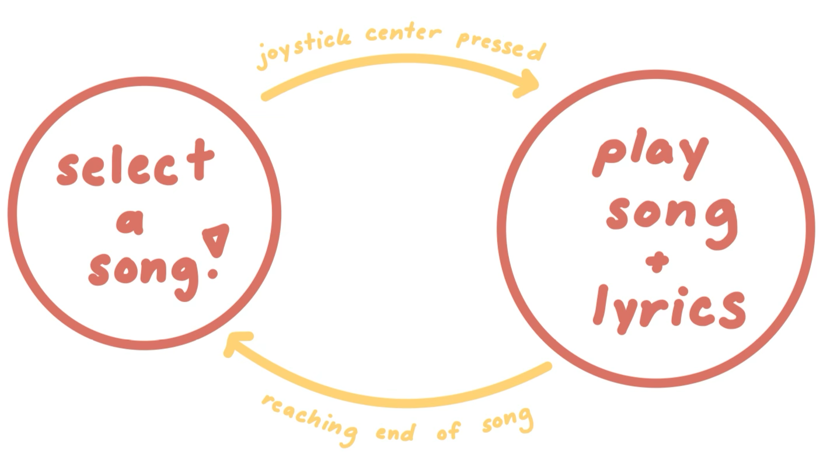
Finite State Machine
Notes:
Our “FSM” acts as a map that guided our project design. Like most karaoke machines, our project has two states: selecting a song and actually singing it. We toggle between these two states based on different triggers, such as the center of the joypad being pressed to tell the system a song has been selected and when the song has ended to tell the system that we need to pick another song.

Slide 4
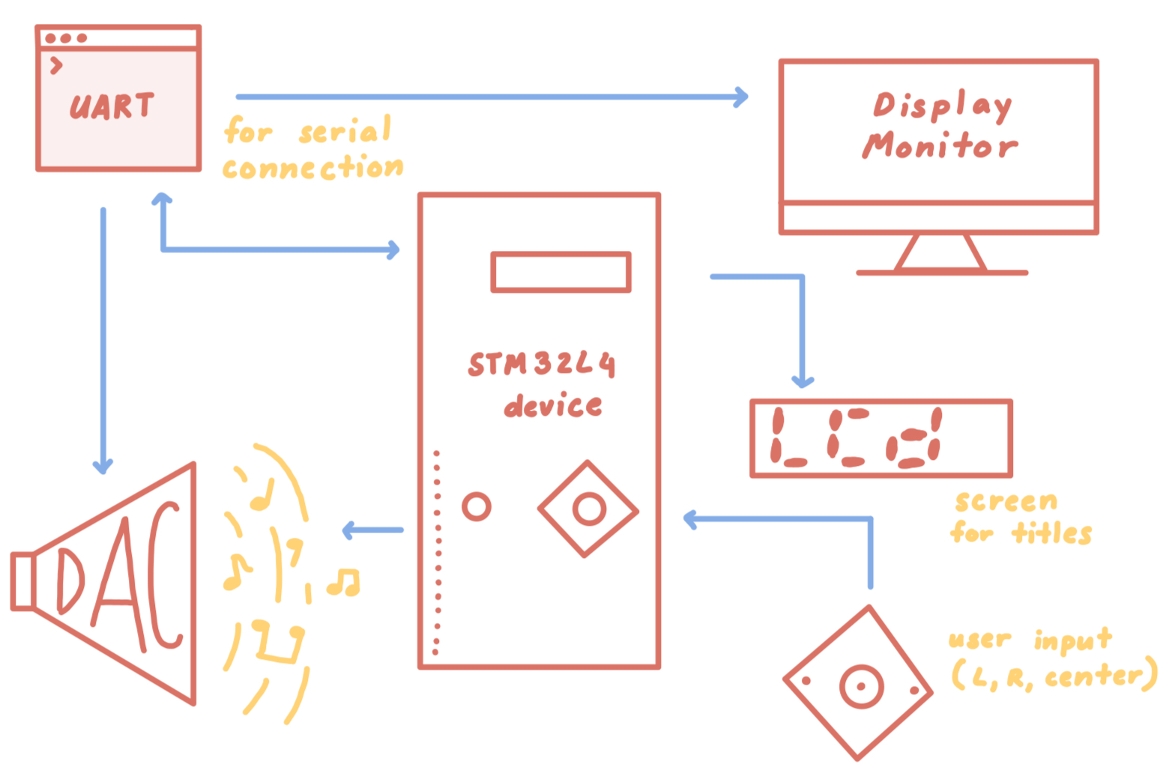
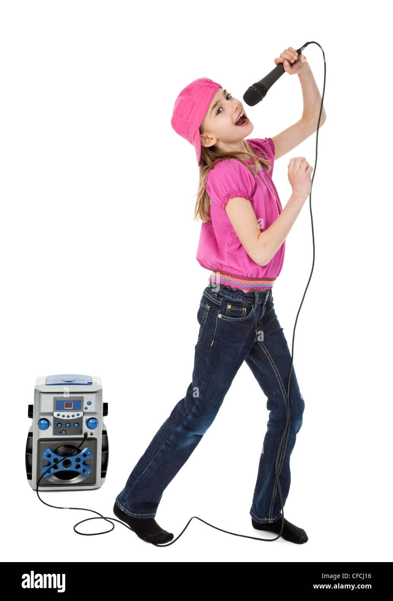
System Diagram
Notes:
How is this all implemented into an embedded system, you might ask? Like this:
Input = joystick
Output(s) = UART, monitor, DAC, LCD

Slide 5
02.
Technical Aspects
Peripherals and Implementations

Slide 6
How Is This All Connected?
Karaoke Machine
UART
LCD SCREEN
Joystick
DAC
Displays lyrics and user interface
Displays song titles
Serves as input for selecting songs
Serves as audio output for songs
Notes:
We implemented 4 peripherals into our project, including the new peripheral of the DAC.

Slide 7
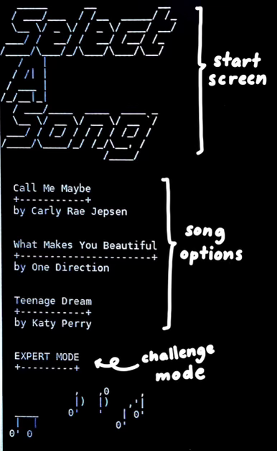
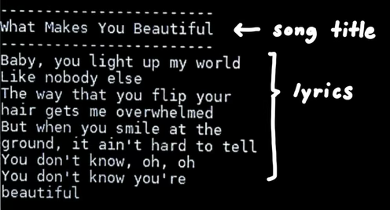
UART
Notes:
As seen, the UART is the main user interface for our project. The user can see all the available songs and the artists and use the joystick to select the one they would like. We used a buffer of size 32, equivalent to a word, to hold the string that would be printed to the serial interface. We found that if we tried to include the entire lyric on one line, for example of buffer size 160, the LCD would start freezing. We suspect it had to do with too much memory being using by the UART, since the peripherals on the STM32 only get 0.5GB. As a result, we had to break up the lyrics into shorter chunks.

Slide 8
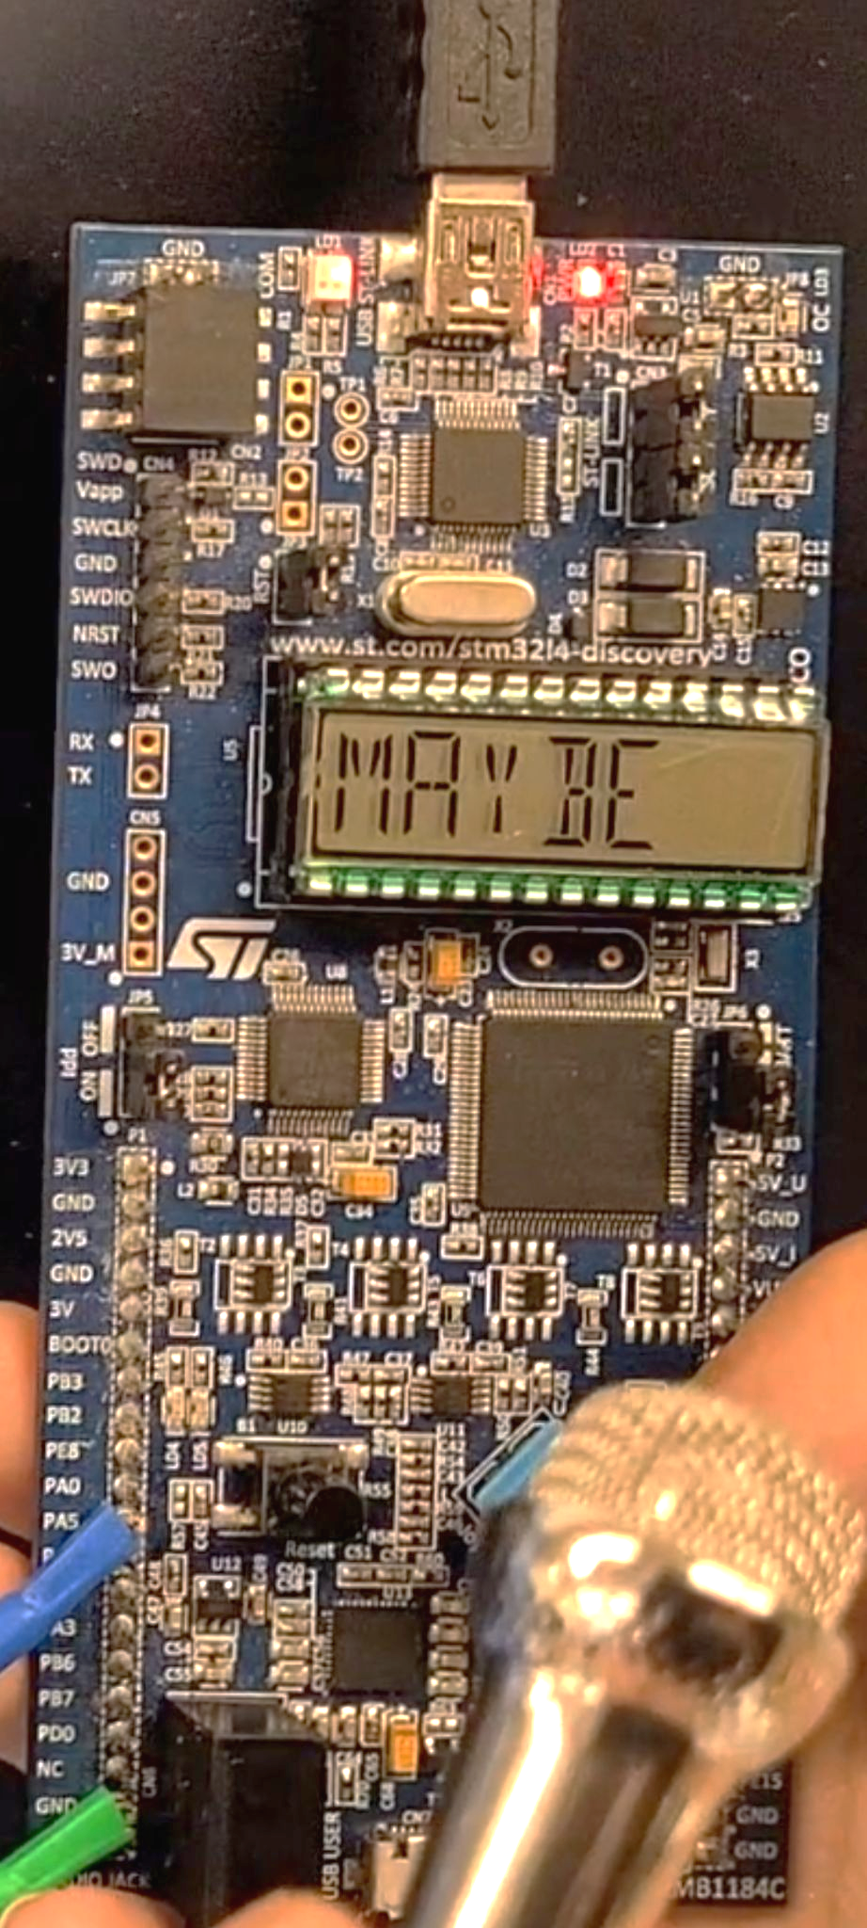
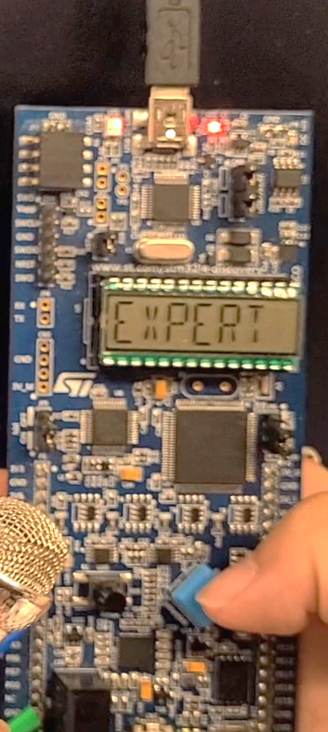
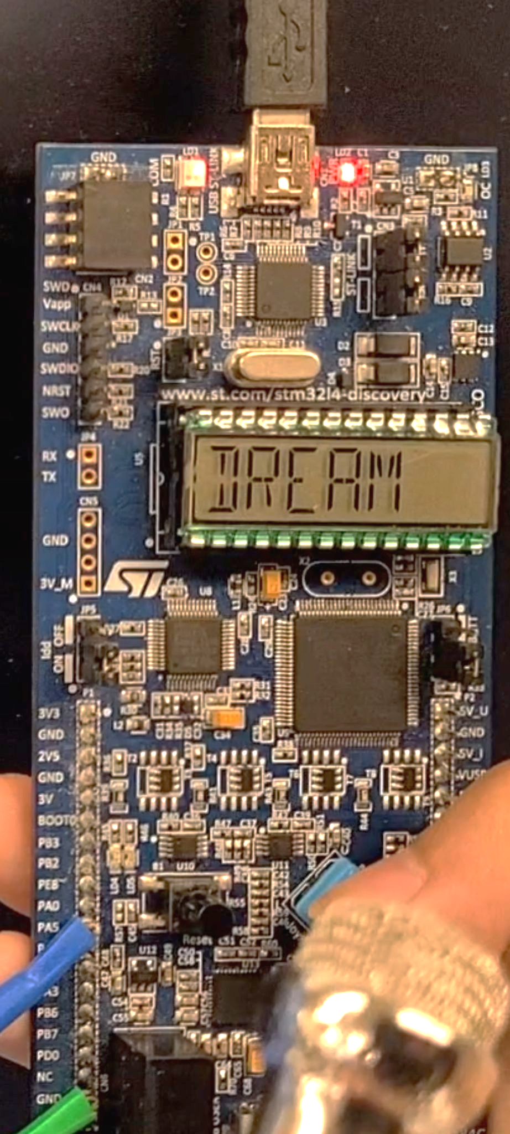
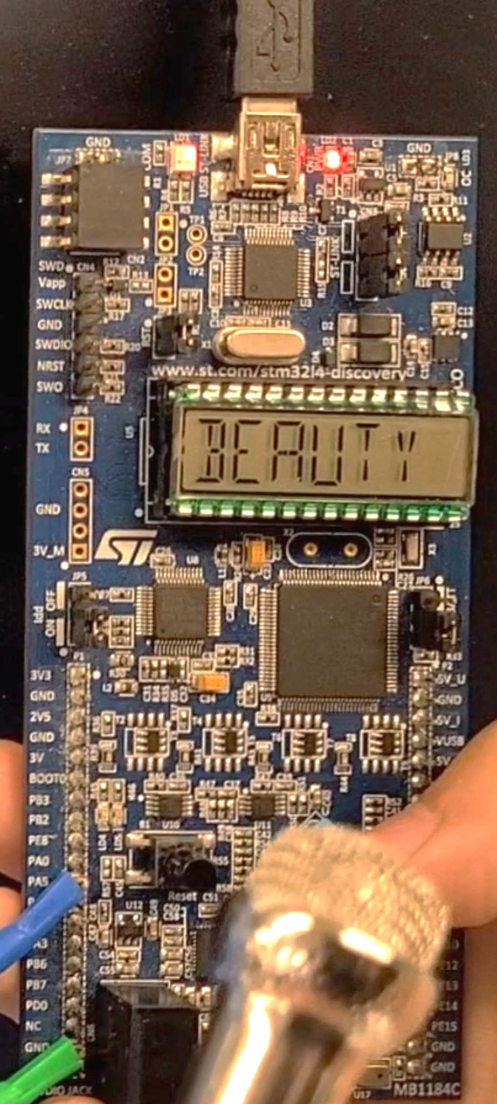
LCD Screen
Notes:
Next up is the LCD! We chose an arbitrary order to implement the songs. We also displayed a keyword from each song, with the exception of “expert”, which is intentionally ambiguous. The user is able to loop through all the song titles through the left and right buttons.

Slide 9
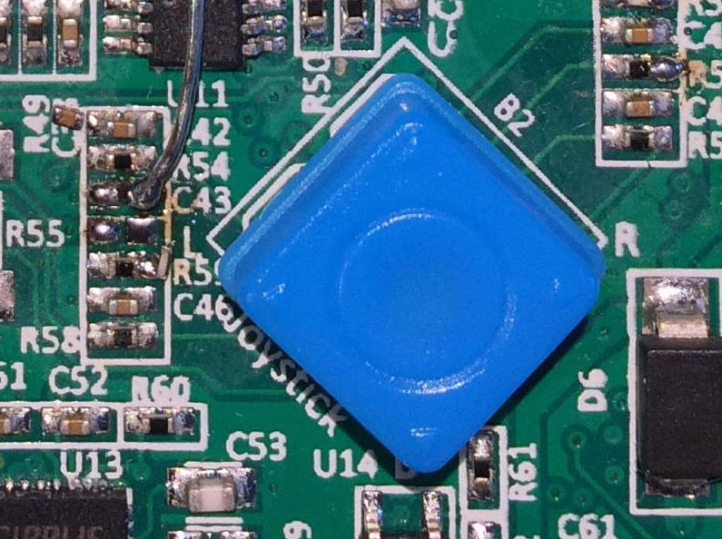
Joystick
4 cases to change between the LCD text
Increment or decrement count when pressed
Set to 0 or 3 to create loop around
Center to select
Notes:
Our final familiar peripheral is the joystick. We wanted the user to interact with the STM board similar to how they would with a TV remote in an actual karaoke room. We had 4 switch-case statements inside of a while loop alongside a count variable to track which song the selection corresponded to. We would decrement a count variable when the left button is pressed and increment the count when the right button is pressed. We wanted the user to loop through the songs, so we limited the count to be within the range of 0 to 3, so when it got larger than 3, we set it back to 0, and when it got smaller than 0, we set it to 3. As mentioned previously, the song options can be changed through the left and right buttons. When the user comes upon a song they want to sing, they would press the center button. We will see this in action later.

Slide 10
Introducing: DAC
STRUCTS
SOUND
the Digital-to-Analog Converter
Containing data pertaining to each individual note, its volume, and longevity
Converted through the playsong() function that converts these structs into audible notes
Notes:
For our new peripheral, we chose to implement the digital-to-analog converter (or “DAC”) to produce the backing tracks needed for our karaoke machine. At its core, the DAC takes data from an array of structs, containing different values that correspond to the note we want to play, how long we want the note to hold for (in terms of milliseconds), and how loud we want it to play. Then, in C, we have a function that takes that data and sends it to the DAC to actually play the notes.

Slide 11
Notes → Structs
A
C
struct Note {
duration
angle
volume
};
{1000, 13.4, 5}
{500, 15.2, 5}, {250, 15.2, 5}
Notes:
This is a brief overview of how we can represent notes digitally. For the sake of simplicity, we chose to implement songs that were 120 bpm, meaning that each measure of a song would take 4 seconds (or 4000 milliseconds). Knowing this, we determined the duration of a note based on the fraction of a whole measure it was (for example, a quarter note plays for a quarter of the measure, which is 1 second or 1000 milliseconds). The angle, which differentiates each note, was determined through guessing and checking.

Slide 12
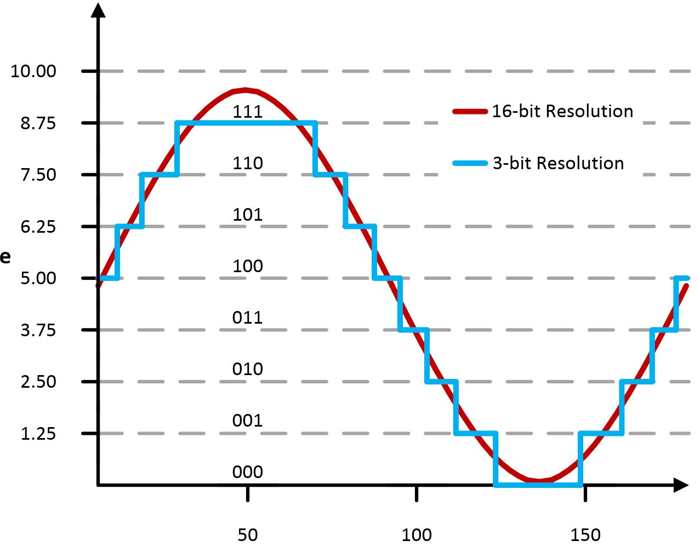
How Does It Work?
Amplitude
(Volts)
For each struct in a song struct:
Angle = frequency of sine wave
Volume = amplitude of sine wave
Duration = delay before changing to next note
Time (ms)
Sample Song Struct:
struct song lovestory = {48, {{500, 13, 5}, {500, 13, 5}, {1000, 17.4, 5}, {500, 16.5, 5}, {500, 14.6, 5}, {1000, 13, 5} ... {1000, 13, 5}}};
Notes:
The data from the structs is what creates notes in the song. In each note struct, the device takes in all the necessary information and translates the digital square wave into an acoustic analog wave to send to an amplifier (like a speaker) to ultimately transmit sound. The angle and volume determine the frequency and amplitude of the sound wave (where lower notes have lower angles). The duration thus works similarly to a delay, dictating how long to hold the note for.
Nerd alert: The song structs can be interpreted as measures of music!

Slide 13
But Wait…
Technical Difficulties

Slide 14
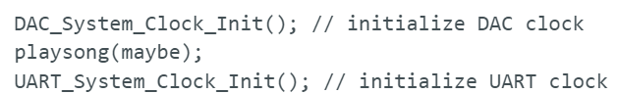
Adjusting the Clock
Notes:
Our main issue was from the clock. The DAC used a frequency of 16MHz and the UART was running on 80MHz. If we tried running everything on the DAC clock, we saw that the UART was just printing blocks of uninitialized values. On the other hand, when we switched to the UART clock, the DAC would play the notes really quickly and not sound like the song at all. We found that one solution would be to initialize the clock before using the respective features, as seen on the slide. Before we enter the case statements, we initialized the UART clock to print the start screen. Inside each case statement, we print the lyrics, then switch to the DAC clock to play the song, and afterwards, switch back to the UART clock.

Slide 15
03.
Results

Slide 16
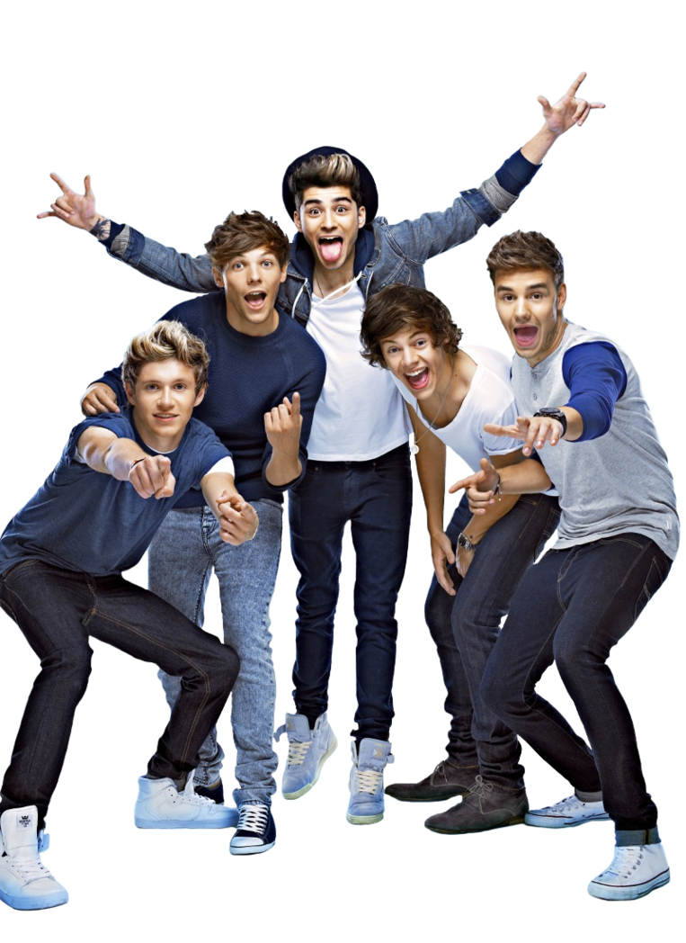
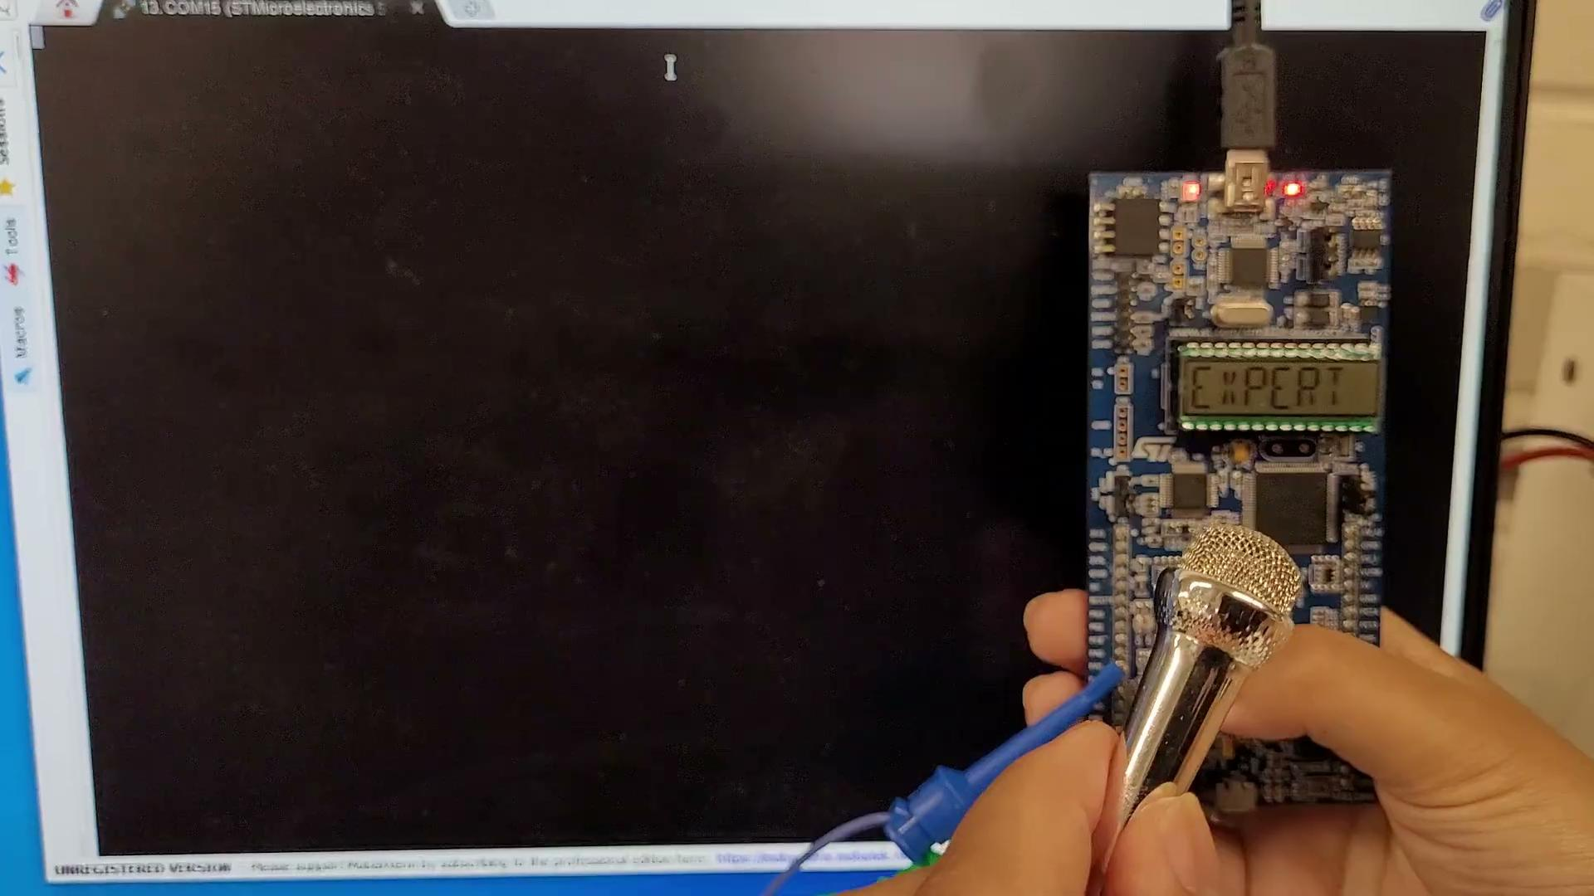
Karaoke Demo
Notes:
Here is our project in action with 3 of the songs we implemented! Can you recognize the songs and sing along?

Slide 17
It can also do the karaoke-ing!
Notes:
Not only can someone sing along to the chorus, the board can also sing along to a karaoke backing track!

Slide 18
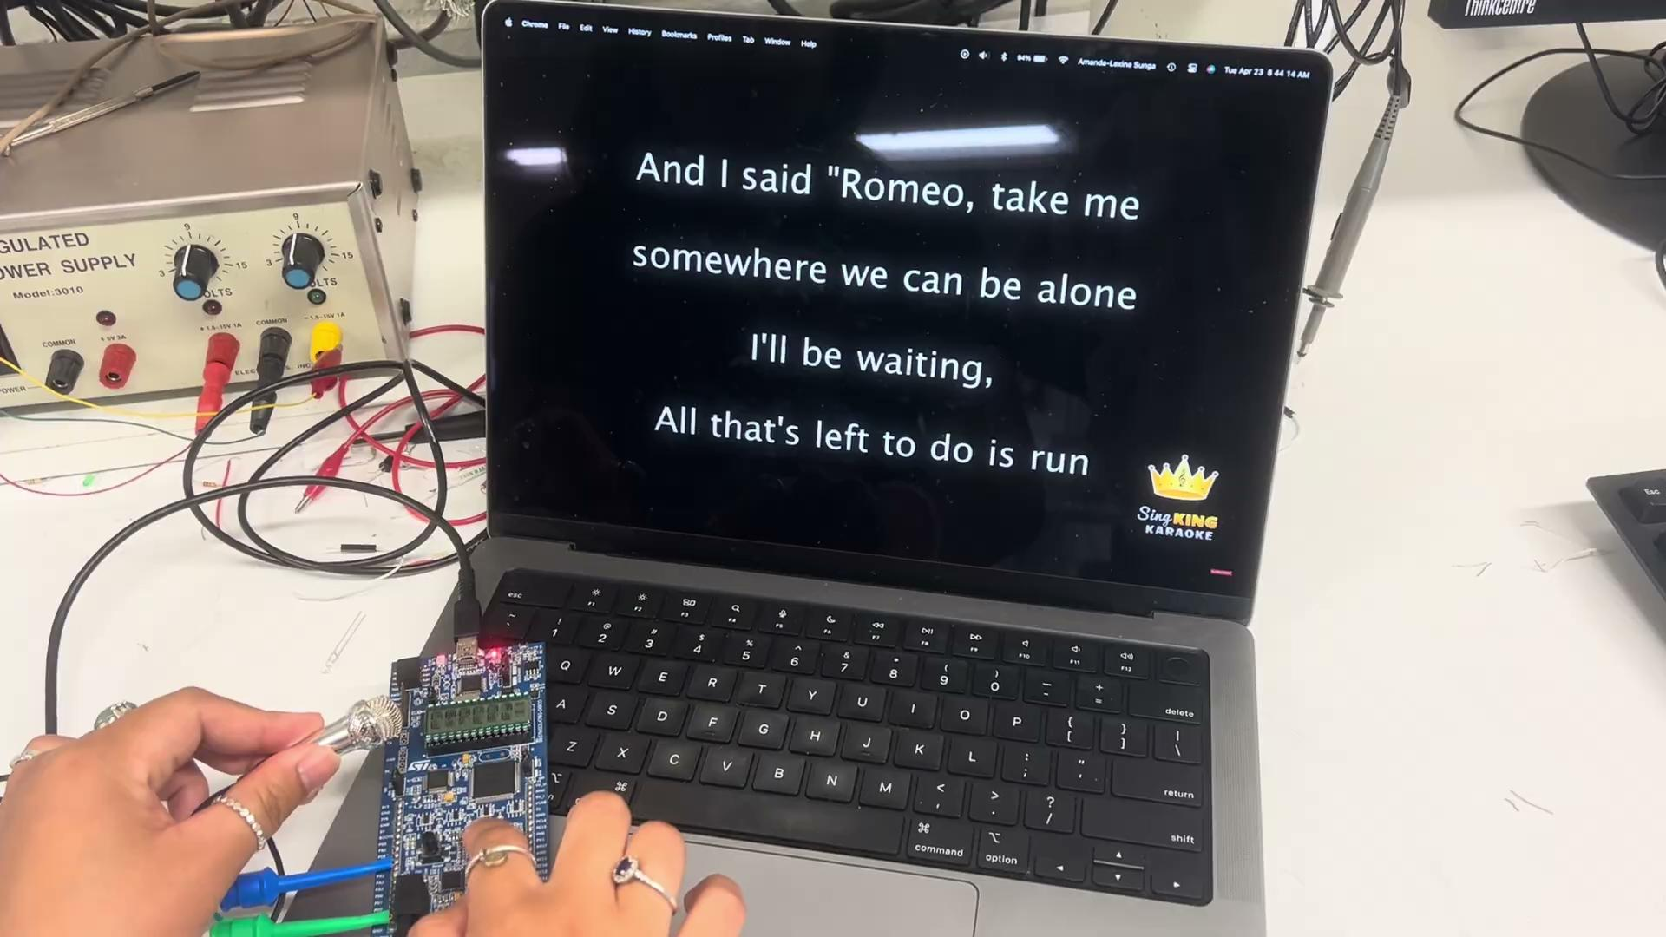
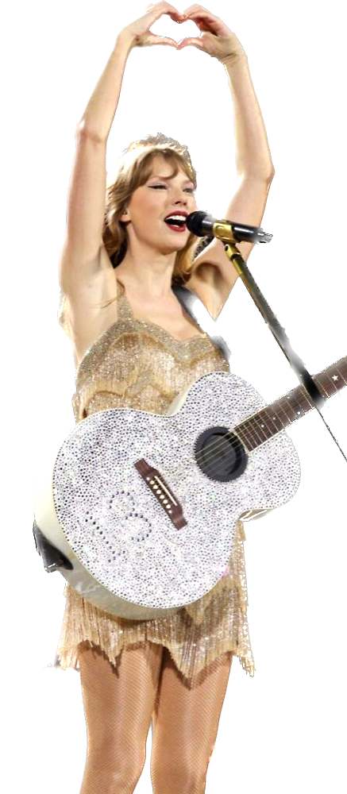
Notes:
Here we have “expert” mode! Just another example of how computers are going to replace us in the near future…

Slide 19
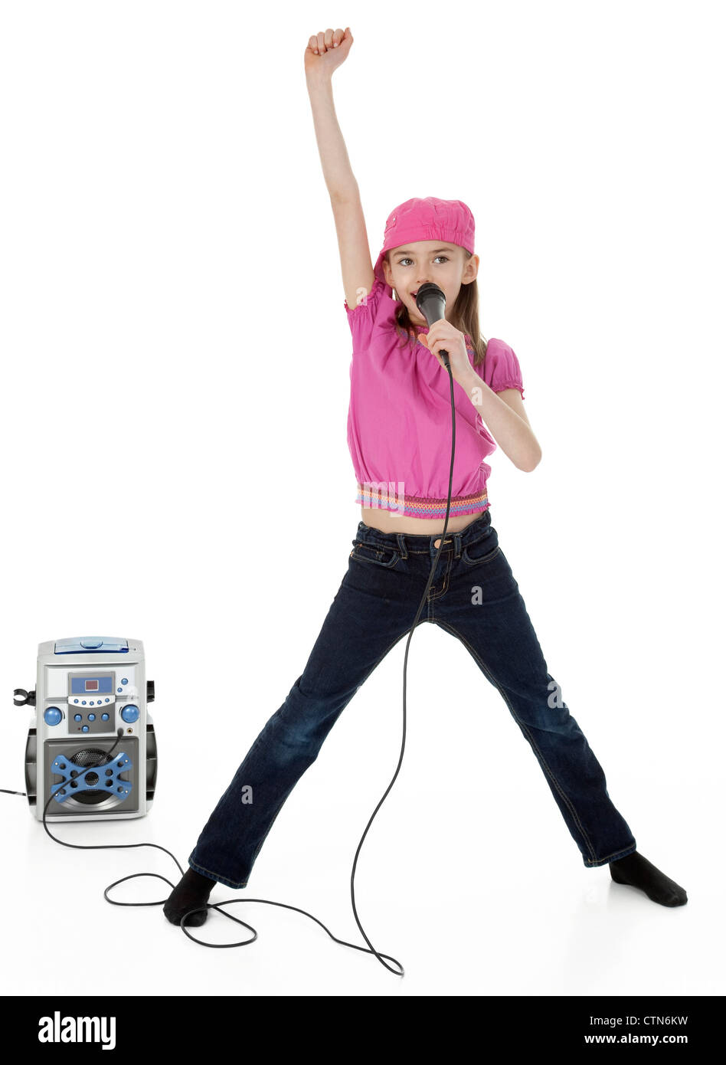
Thanks!
Any questions?

